Slide 1

CS562-A
Final PROJECT
ZHIPENG YIN
Zichong Wang

Slide 2
Standard SQL Query
Ad-hoc OLAP queries expressed in standard SQL. OLAP queries can be also considered as data mining.
Ad hoc OLAP Queries is little has been done on query optimization of complex ad hoc decision support queries. To express such queries in SQL, a high degree of redundancy is required: multiple self-joins, correlated subqueries and repeated group-bys. This leads to complicated queries, difficult to understand and optimized.
The problem is that a traditional SQL optimizer will not consider the “big picture”, but will try to optimize a series of joins and aggregations, which is not always the best approach.
Standard SQL require several views joined together or correlated subqueries. These complex representations lack succinctness, a necessary aspect for efficient optimization.

Slide 3

Project Purpose
For this project, we build a query processing engine to improve Ad-Hoc OLAP queries efficiency. The project accepts read queries in the specified format. After that the project will generates a Query file. Based on the compiling and running the Query file, the project can output the result for the input query.

Slide 4

EMF Query
The novelty of Extended Multi-Feature query was the introduction of the concept of grouping variables. We can define for each group several grouping variables. The scope of these grouping variables is entire relation.
The newly introduced SUCHTHAT clause acts as a where clause for these variables: there exists one condition for each grouping variable. These defining conditions may involve constants, aggregates of the group, or aggregates of previously defined grouping variables.
The group by clause is the same as in standard SQL, with the following addition: after specifying the grouping attributes, it may contain grouping variables.

Slide 5
Rough Structure
Translated EMF SQL
Analysis of EMF SQL
EMF SQL
Generate
Start.java
ProjMian
.java
Result

Slide 6
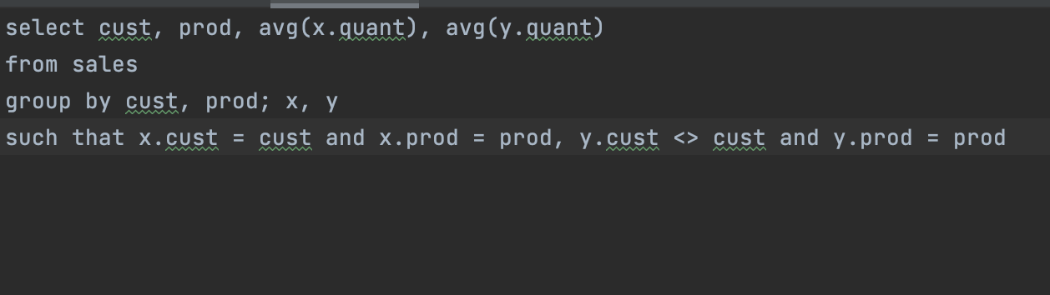
Input Query and Format
Format
In .txt file
SELECT
cust, prod, avg(x.quant), avg(y.quant)
FROM
sales
GROUP BY
cust, prod; x, y
SUCH THAT
x.cust = cust and x.prod = prod, y.cust <> cust and y.prod = prod
HAVING

Slide 7
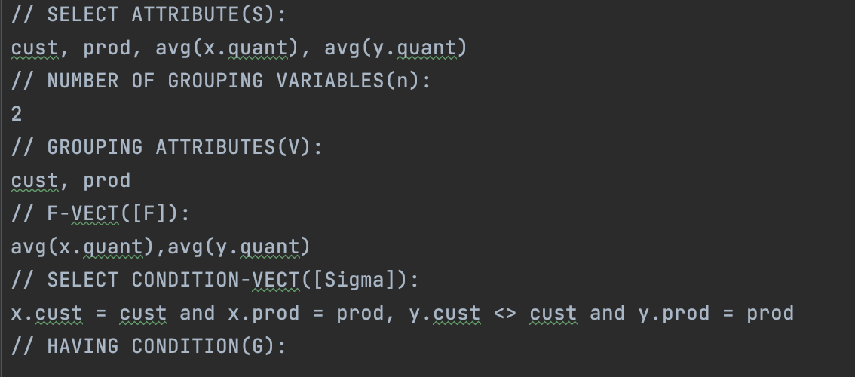
Translate E-SQL
In TXT FIEL

Slide 8
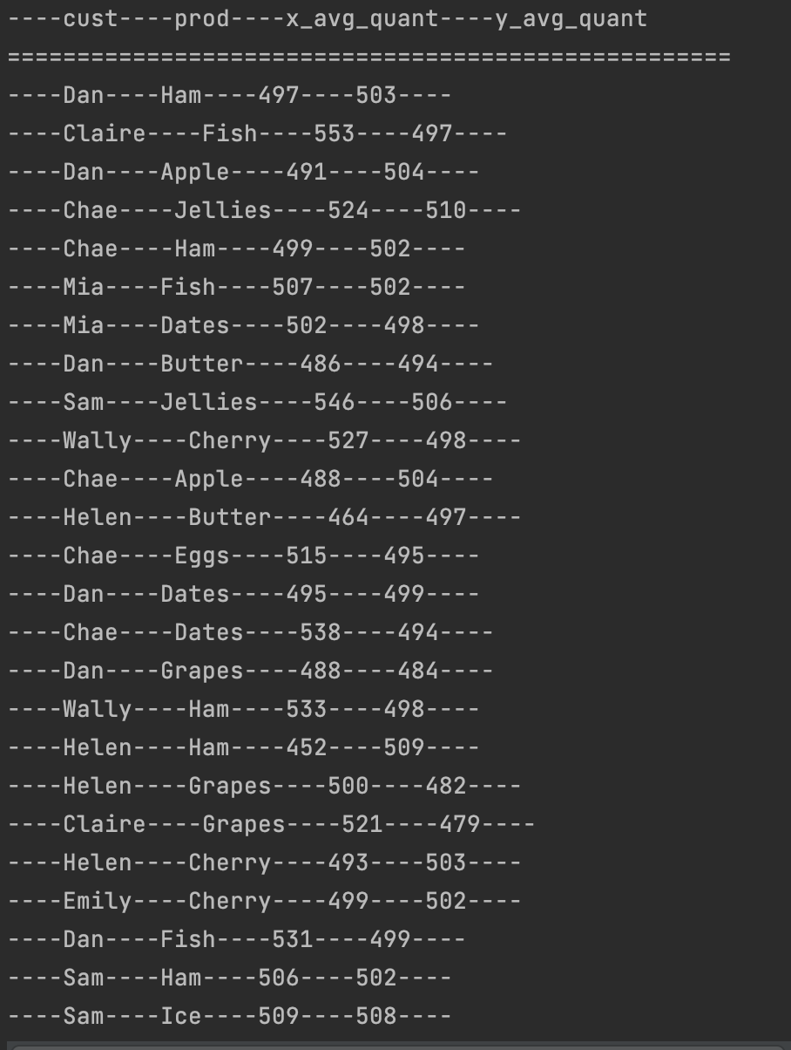
Result
Run the generated start.java file
Output results on the console

Slide 9
Technology and Limitations
Technology
Limitations
PostgreSQL JDBC Driver Version 42.2.12
Regular Expression
Java and Java Swing graphical programming（JFileChooser）
The query process is long and not optimized
Only E-SQL in the above format is supported (no WHERE statement)
The format of the output is not perfect

Slide 10
Summary

